Slide 1
Group 2 Confident Malva
Members : Xiaoge Bao, Jingyi Li, Jian Jin, AthanasIos Kokkinakis, Aikendrajit Ningthoujam, Soumyajit Bose
Project name : “Mice” job, well done !
Special thanks to our TA:Shruti and Noga!

Slide 2
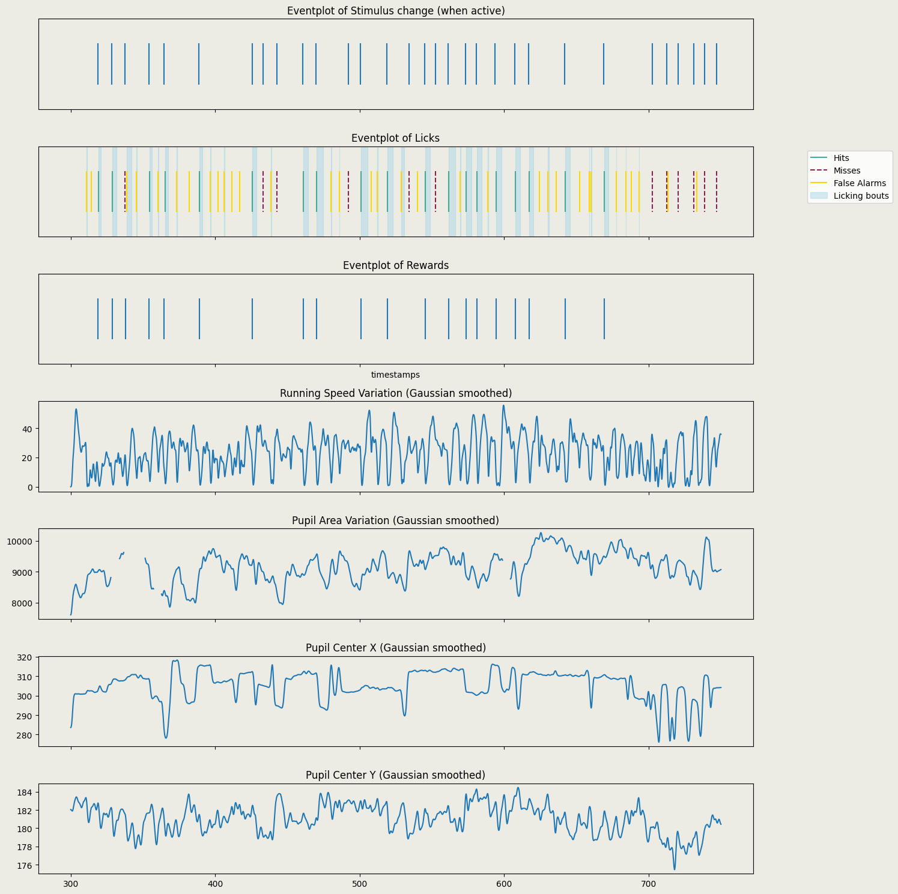
Setup and Introduction
Go/No-Go Task
Earn Reward by licking at changes
Task 1 : Reward-earning strategies
Task 2 : Mice motivation
Task 3 : Neural activity difference for hit/miss/FA/CR
Task 4 : Poisson GLM encoder based on stimulus to predict spikes

Slide 3
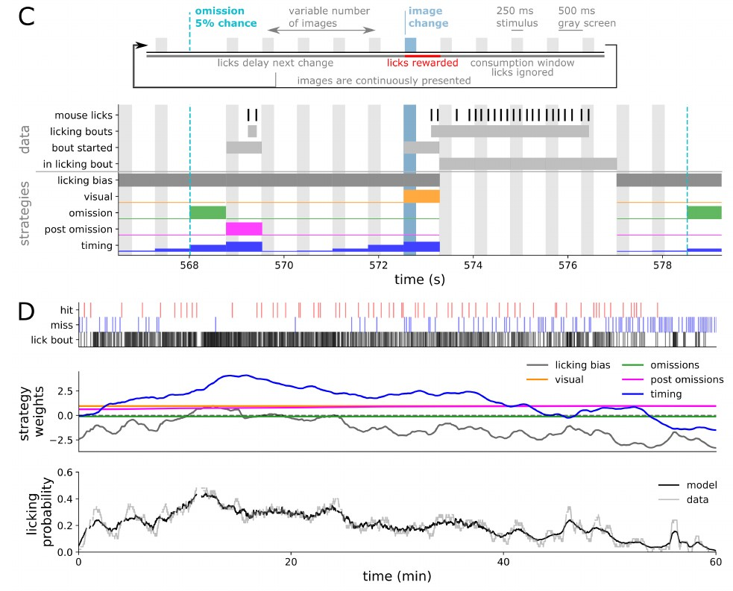
“Strategies” that mice could be adopting To Earn Rewards
Bias - lick always
Image Change
Image Omission
One after image omission
Timing statistics
Dynamic Logistic Regression (PsyTrack)
“Reproduced in spirit” + minor extensions of “Behavioral strategy shapes activation of the vip sst disinhibitory circuit in visual cortex” by Alex Piet et al from Allen Institute

Slide 4
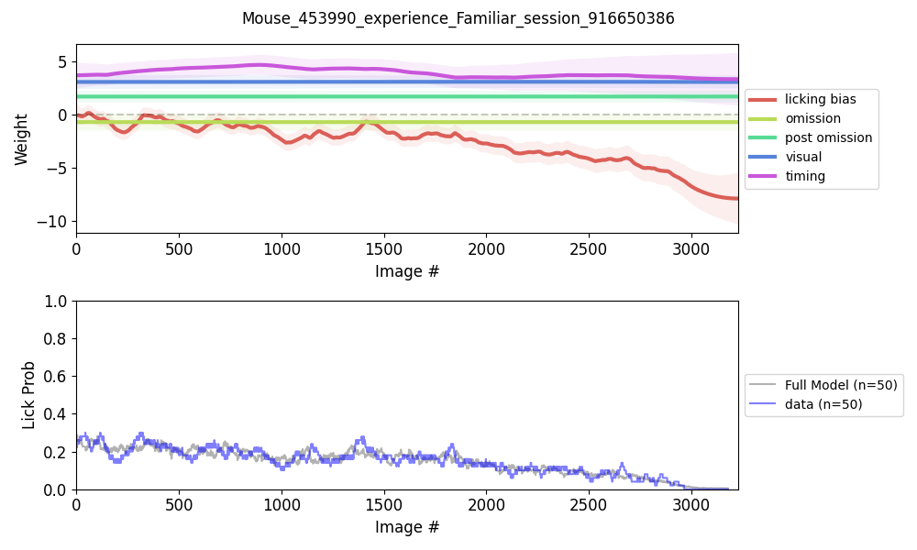
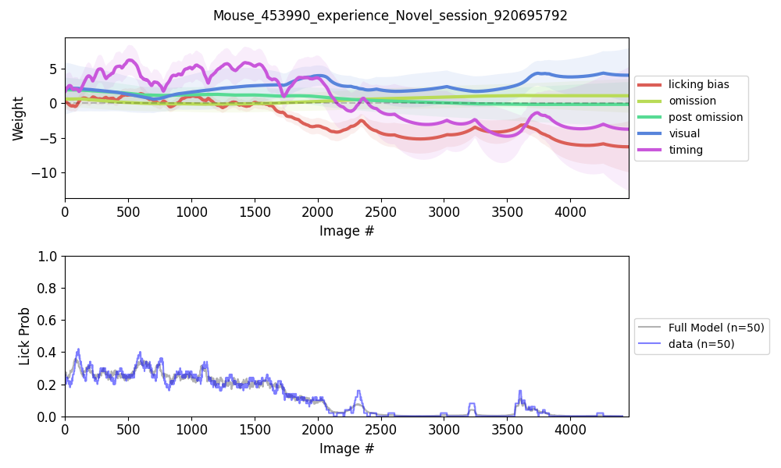
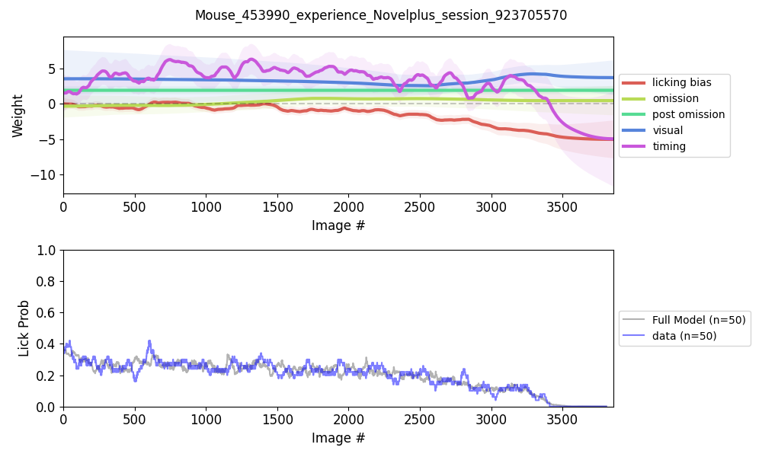
“Strategies” that mice could be adopting To Earn Rewards

Slide 5
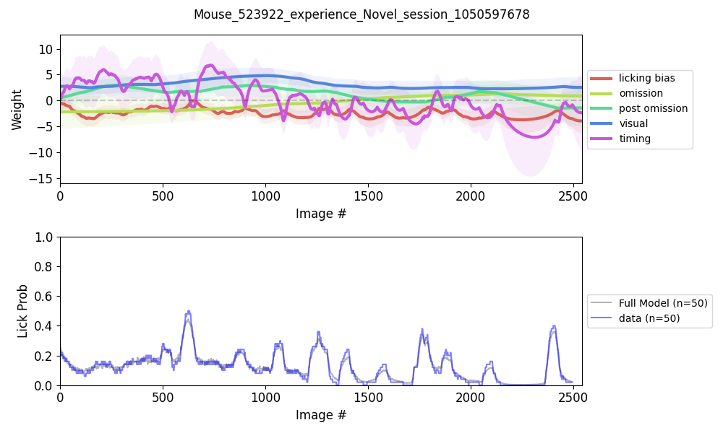
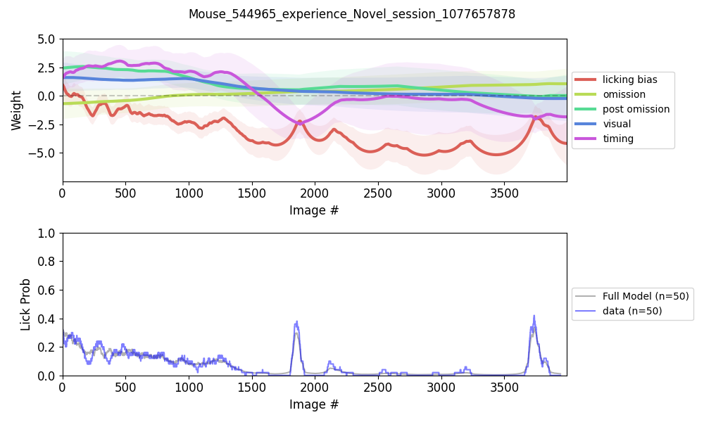
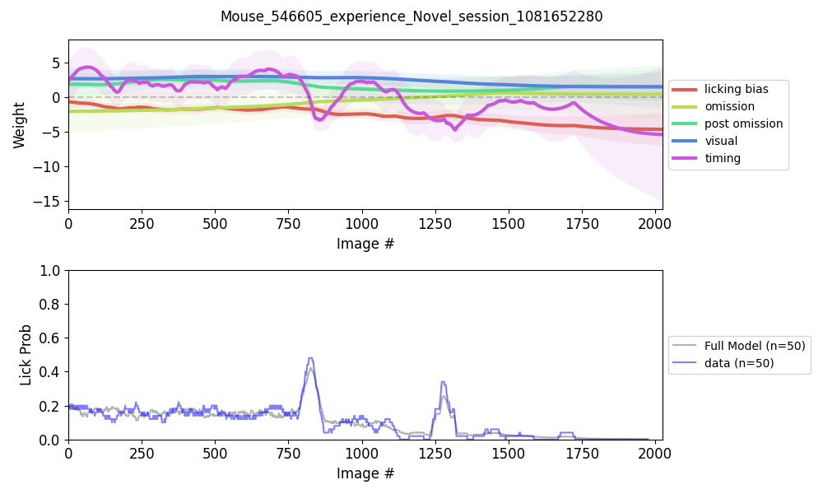
At individual mouse level, possible to see very distinct reliance on different strategies. In these 4 cases, they are kind of similar in the novel Experience Level sessions but …..

Slide 6
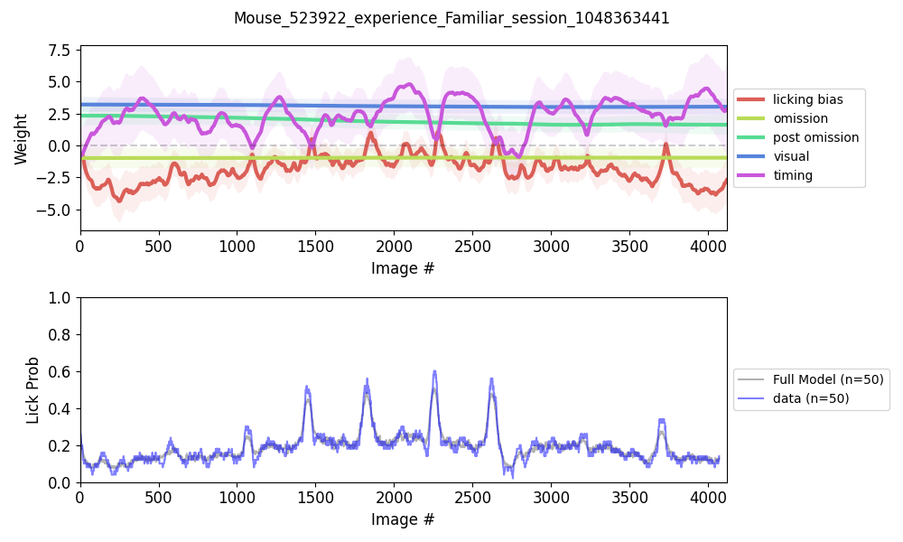
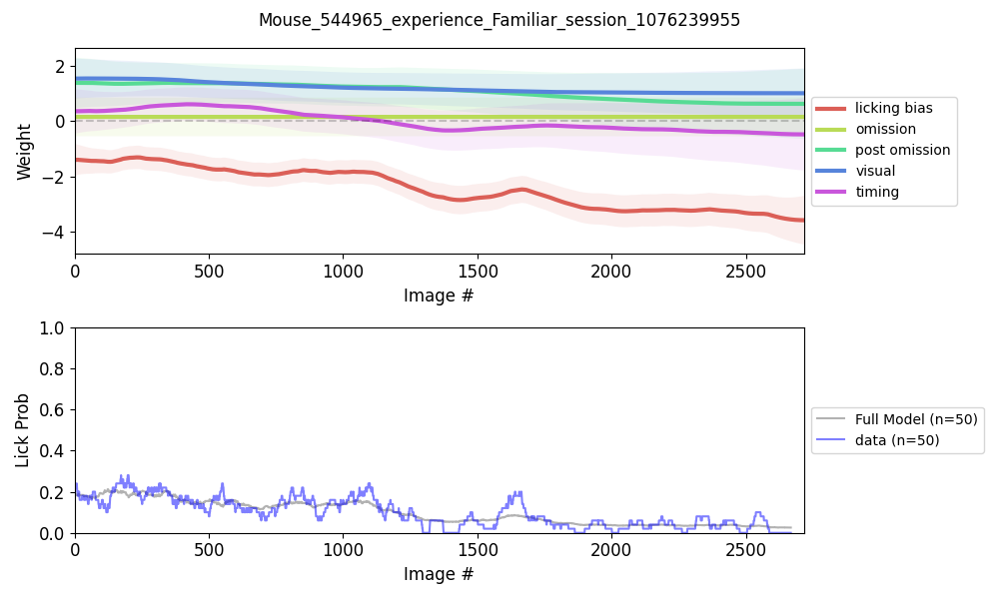
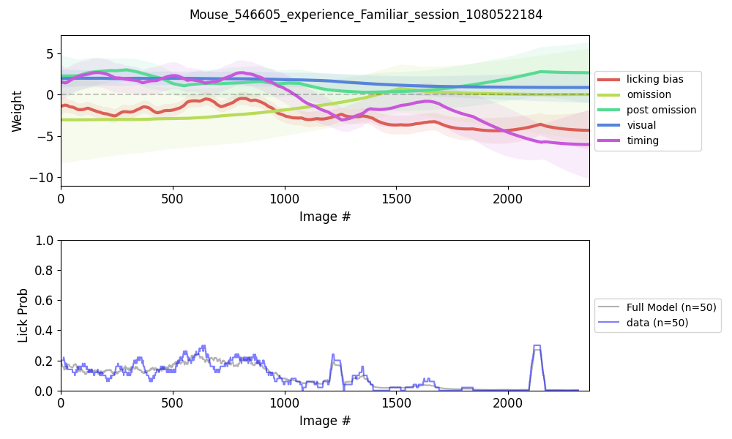
….Quite Different in the Familiar experience level sessions.

Slide 7
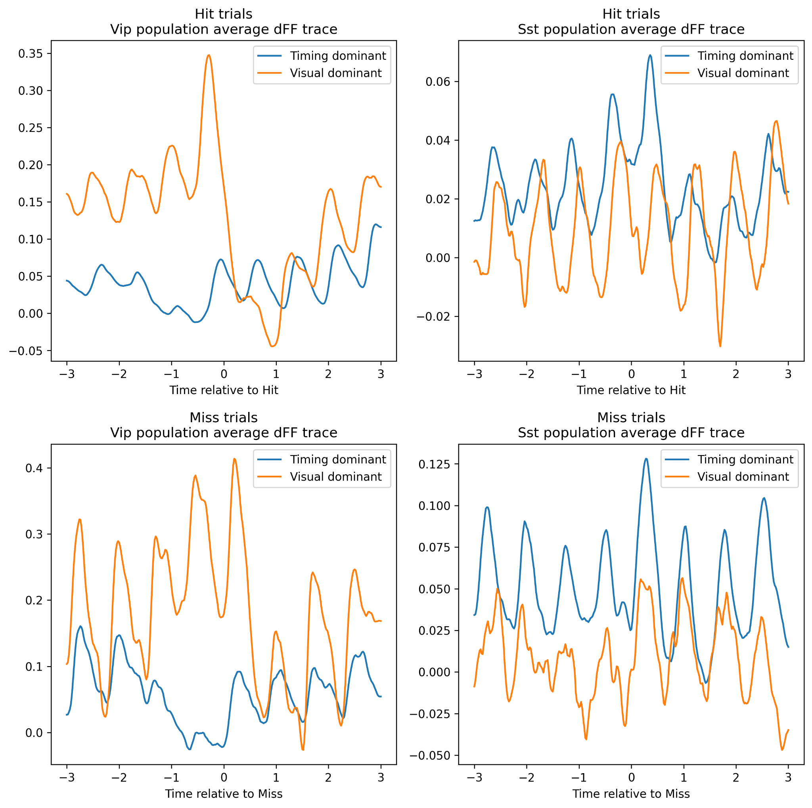
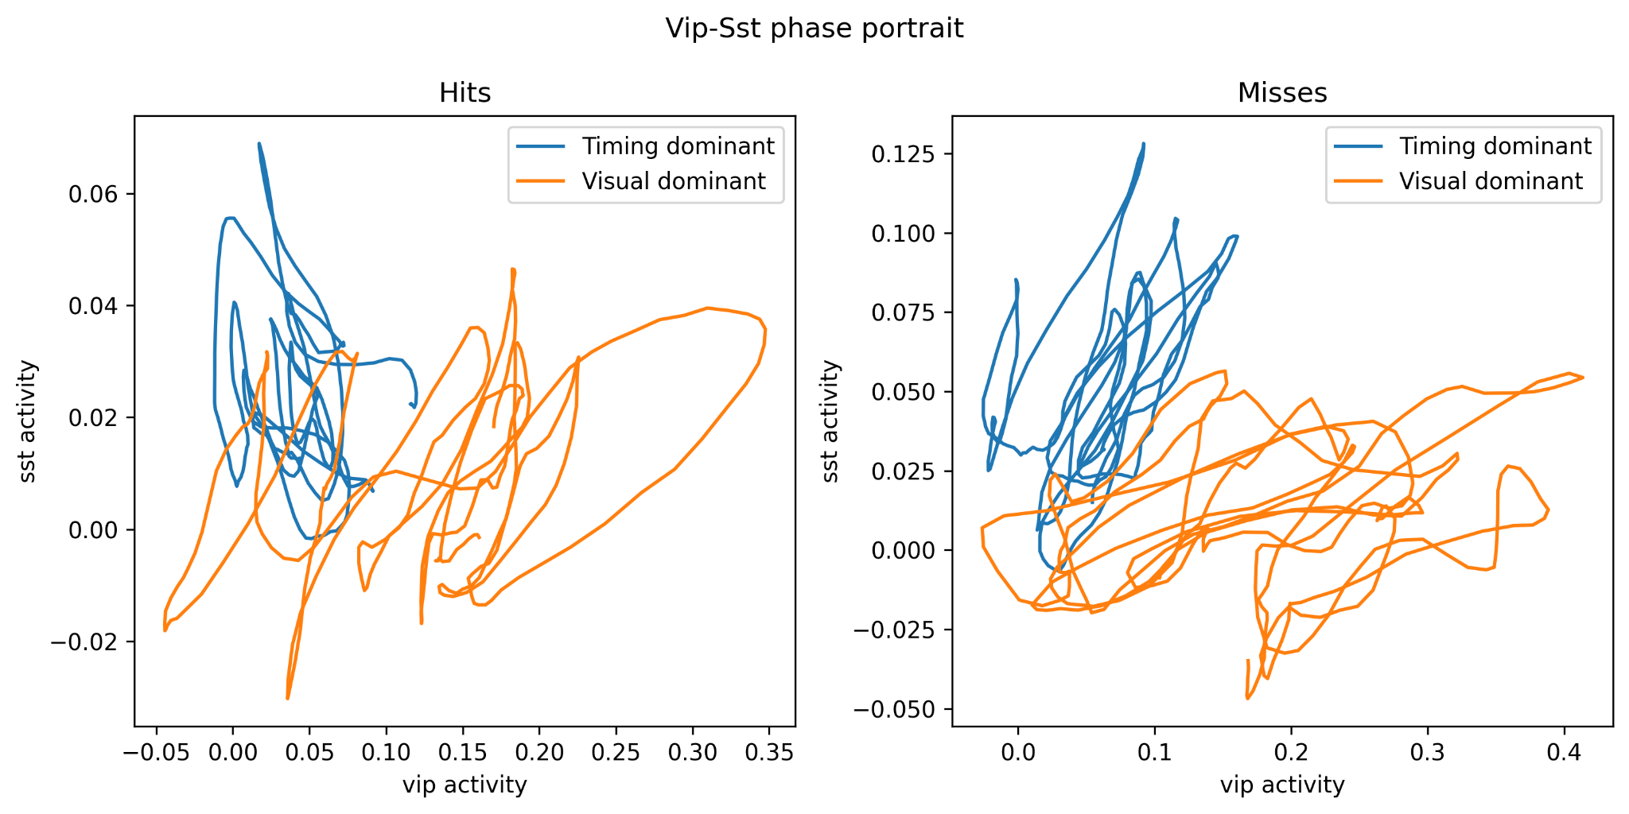
“Strategies” And Neural Activity (Novel Trials only)

Slide 8
Do mice lose motivation/get fatigued ?
Difference between each image onset and mouse response.
Spearman’s rho instead of Pearson’s correlation due to the data not being normal.
Spearman’s rho tends to be more “conservative” and more resistant to outliers because it is a rank correlation.

Slide 9
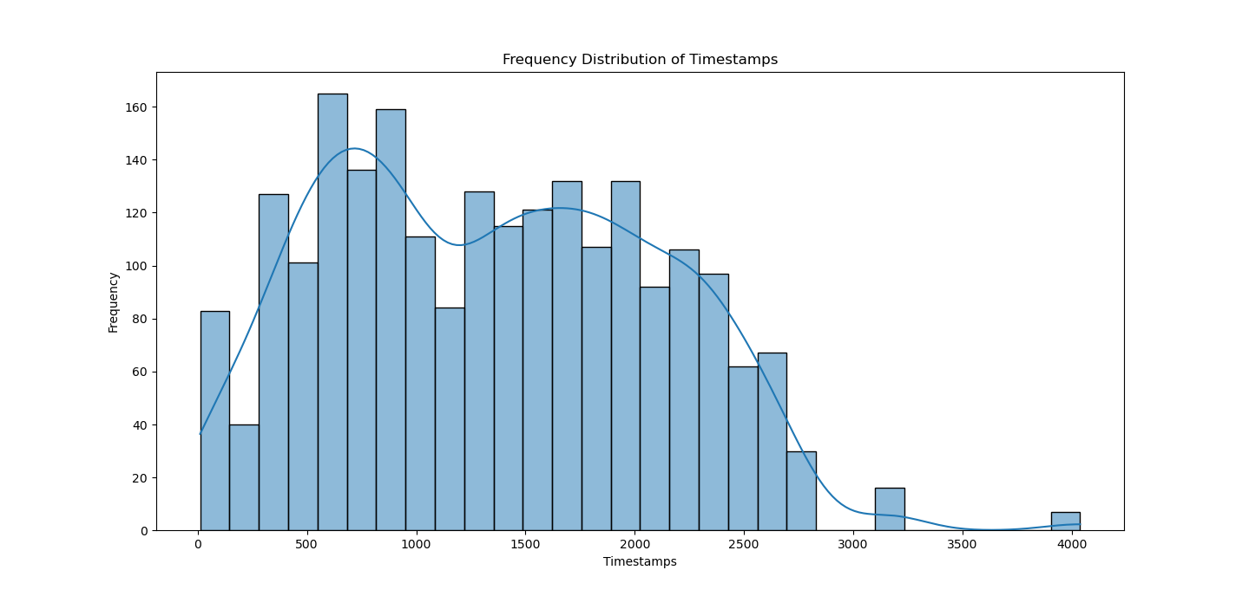
Licks Rates and Distribution from a single mouse

Slide 10
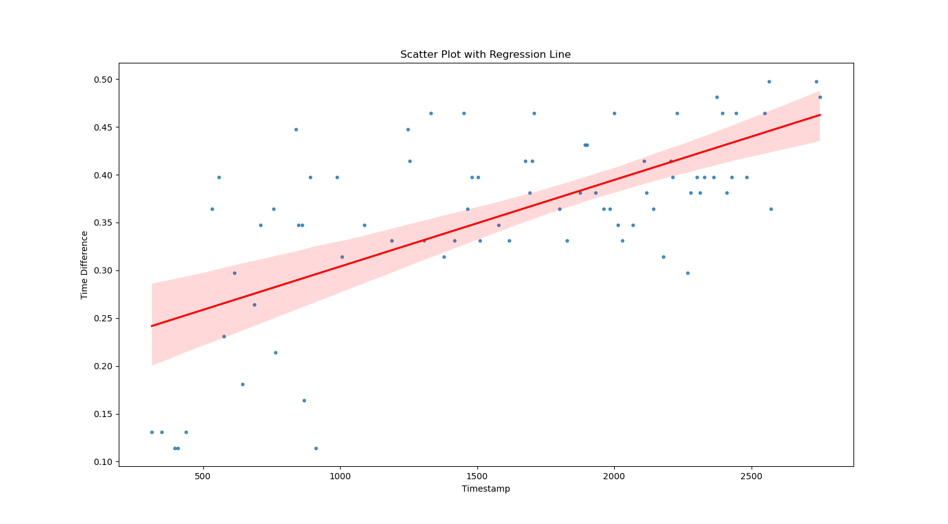
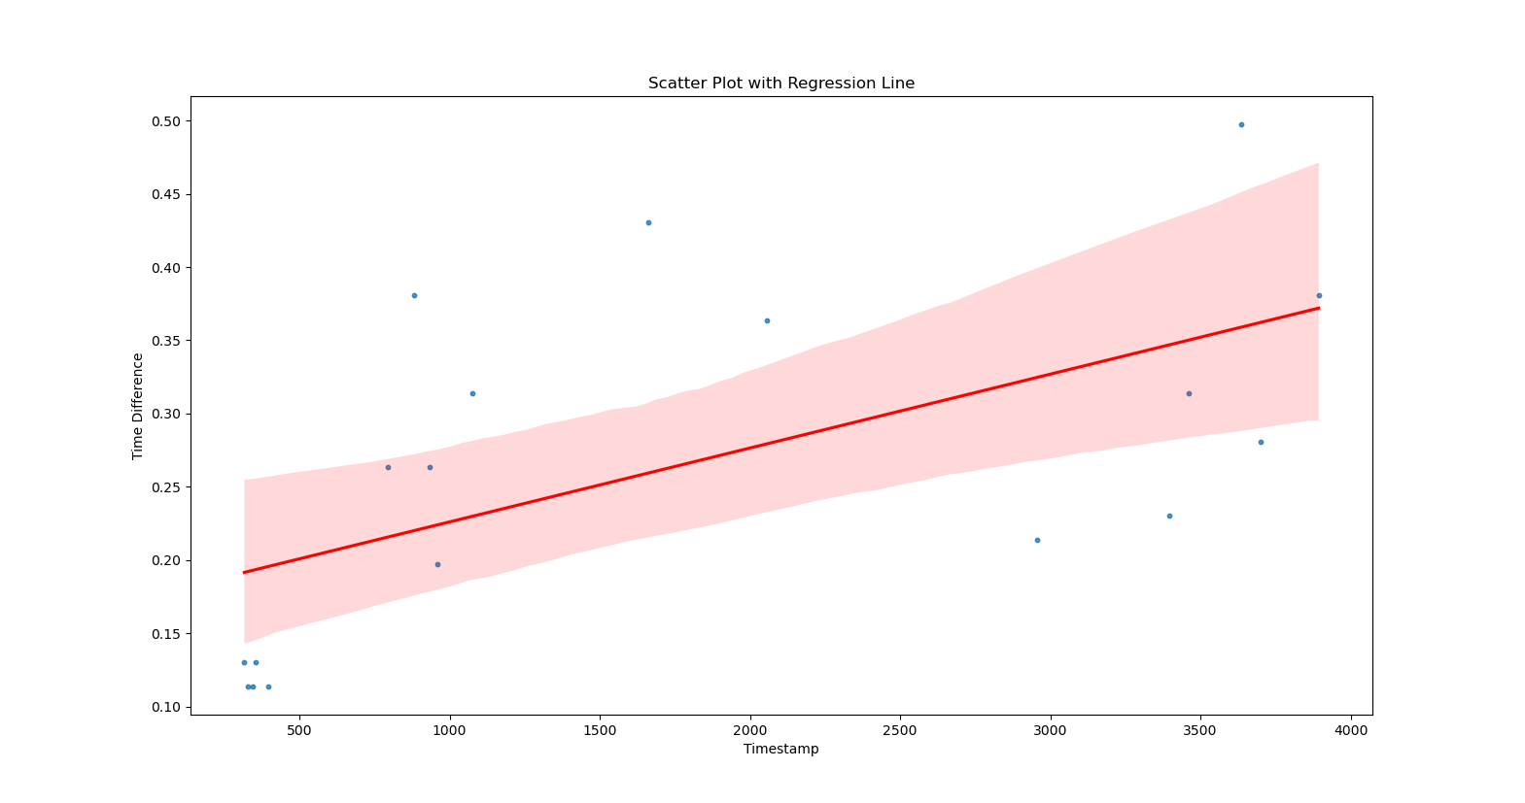
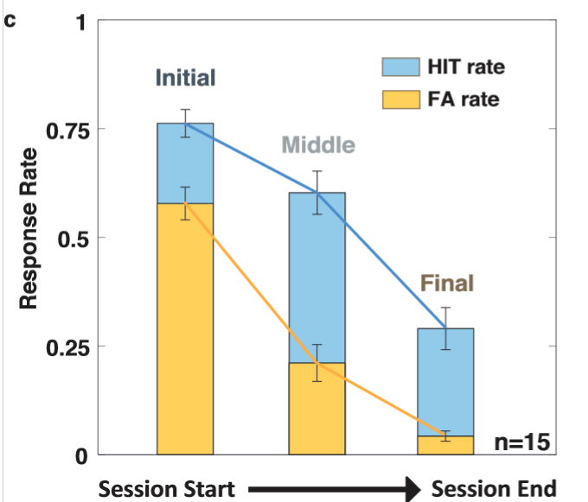
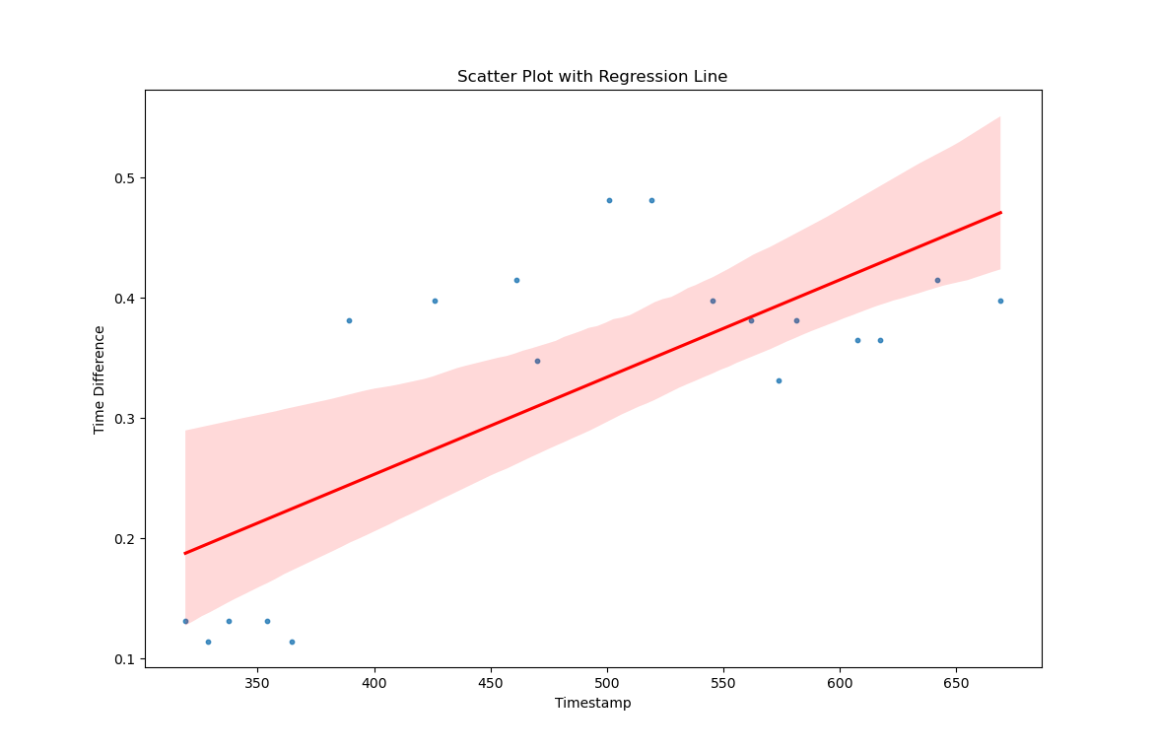
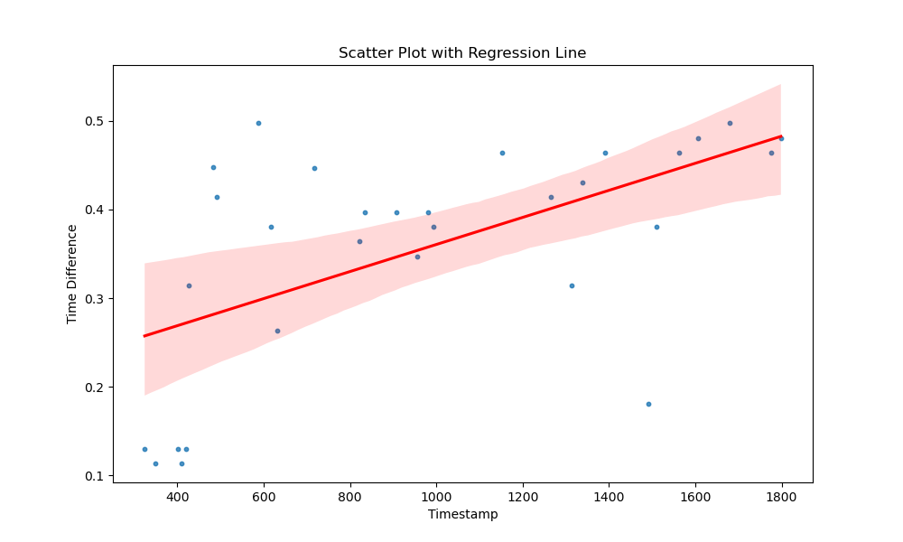
Similar Patterns of Early Fast Responses from 4 subjects

Slide 11
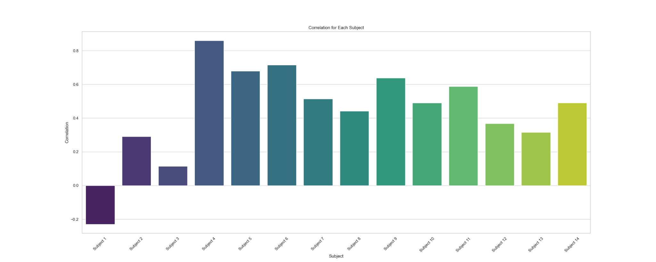
Significant correlations for each subject (Note 1 & 3)

Slide 12
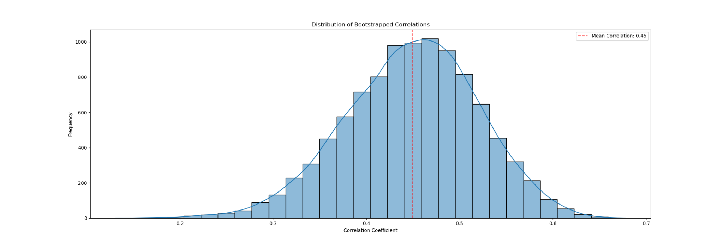
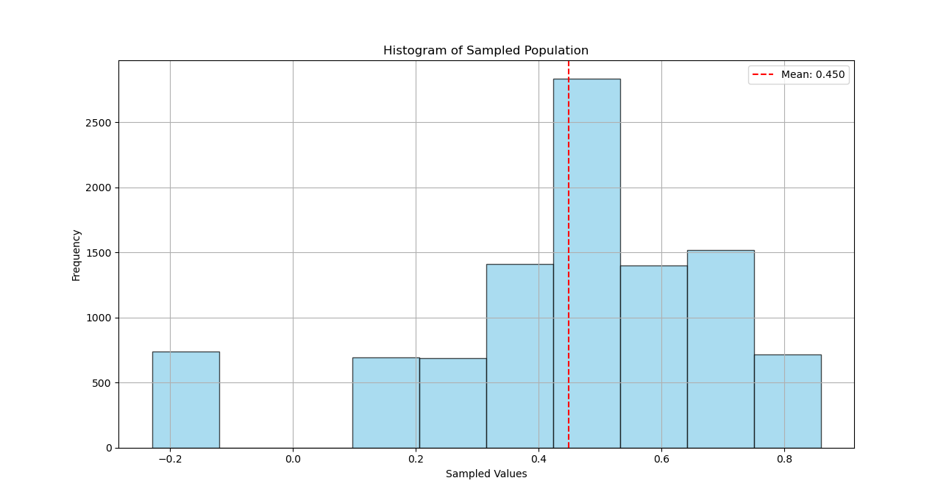
Bootstrap to create a better estimate
Sampling with replacement
“True” Spearman’s ρ=.45
Individual Values
Sequences then averaging

Slide 13
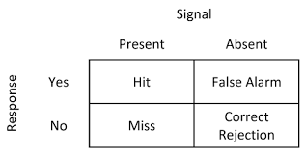
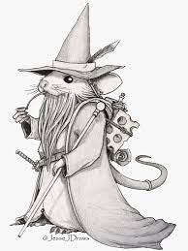
Neural activity and Signal Detection
Do the neural activities of visual cortex predict the choice of Mice?
Does the mice know if the choice is correct before the movement?

Slide 14
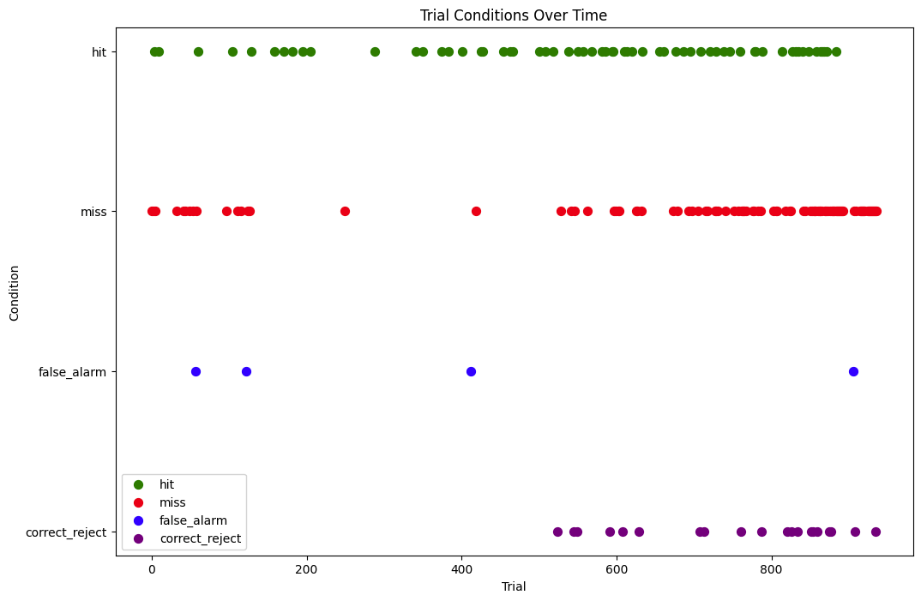
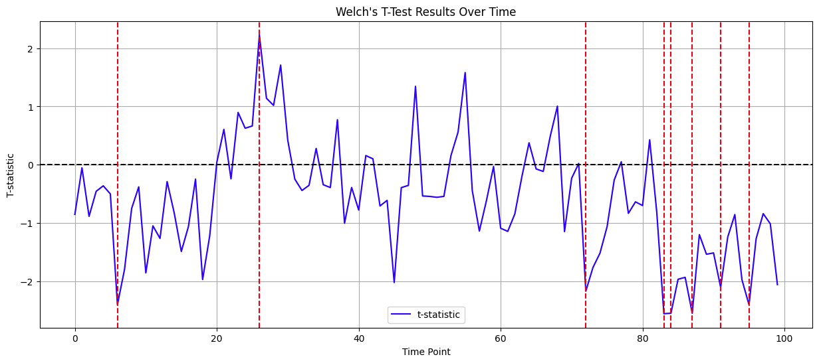
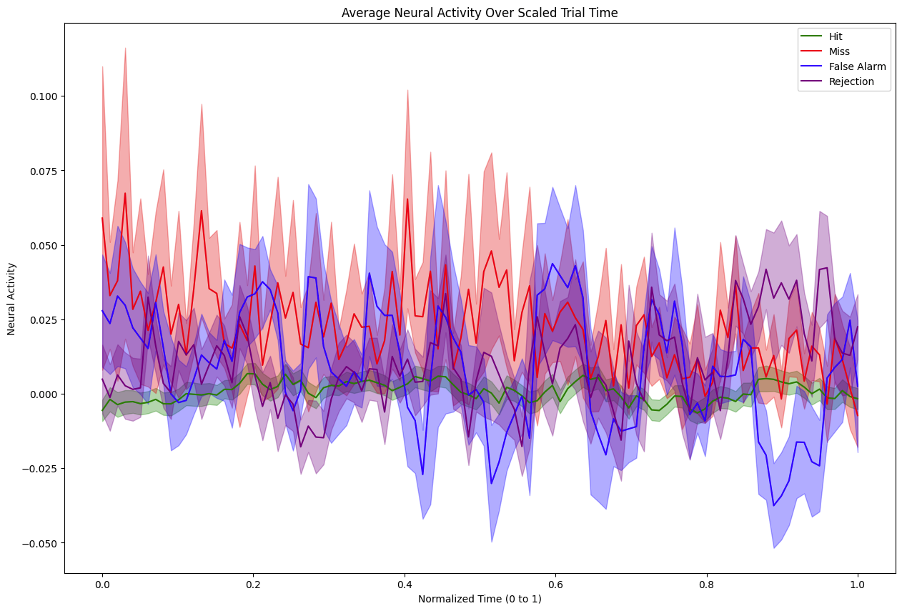
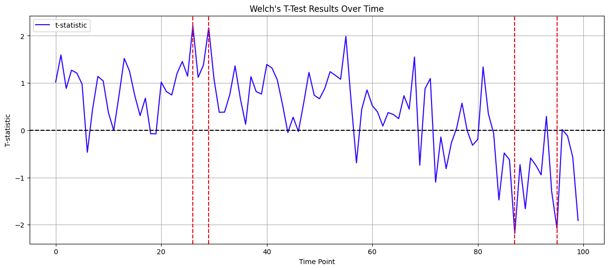
Familiar Session: Hit & Miss & False Alarm & Reject
Hit & reject
Miss & reject

Slide 15
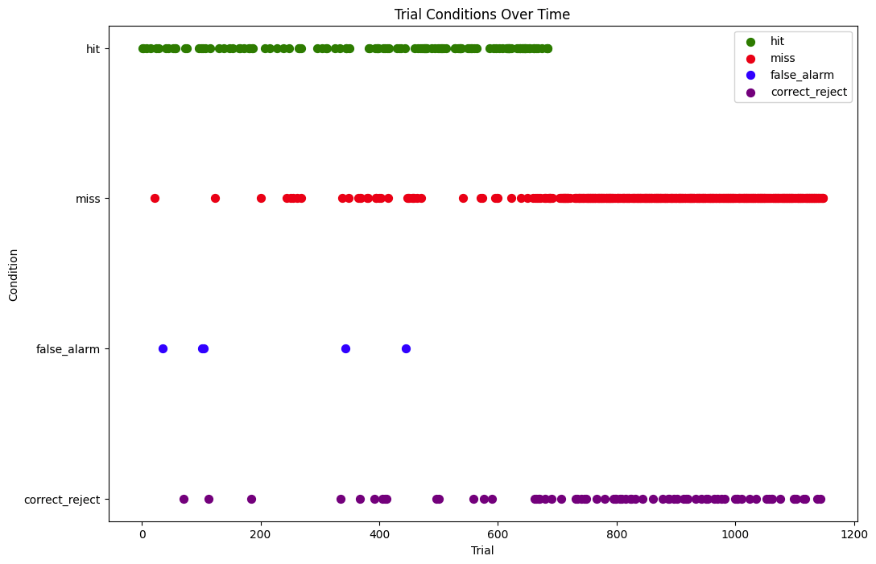
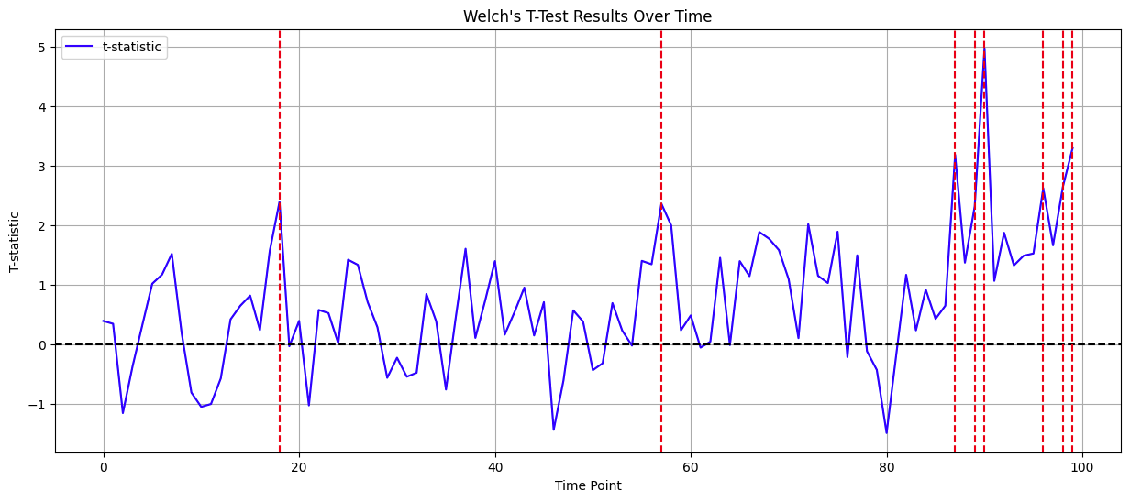
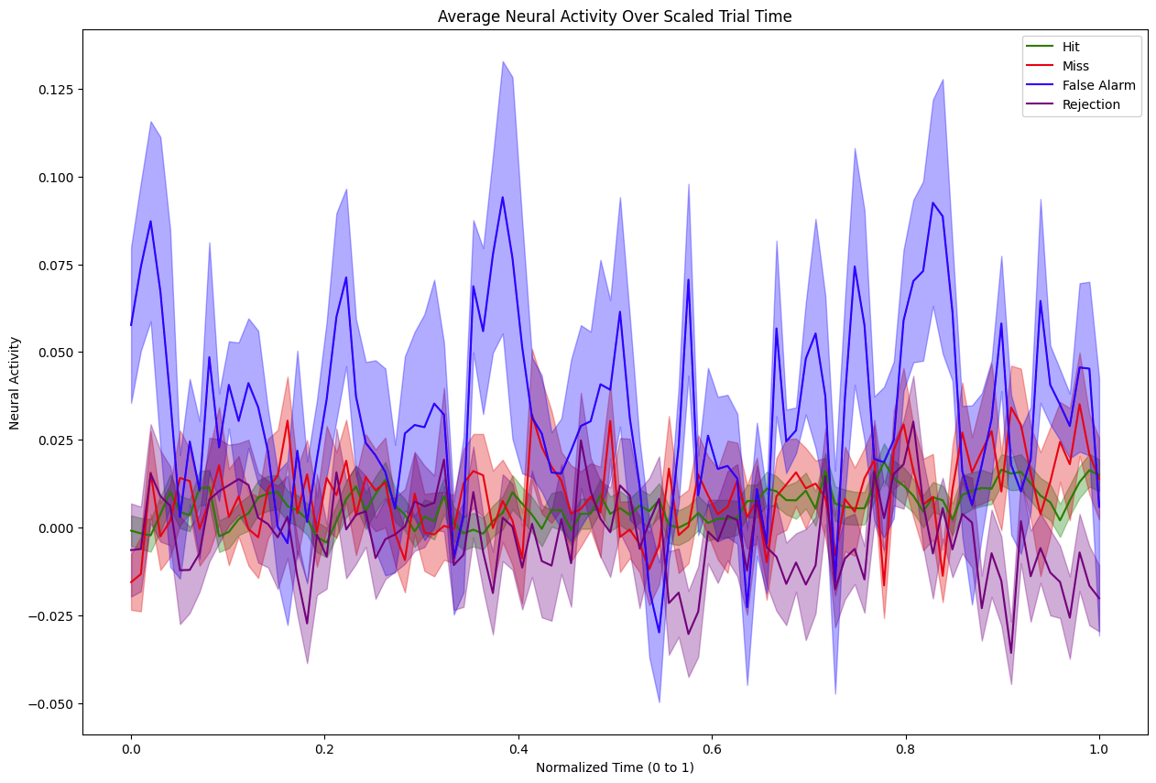
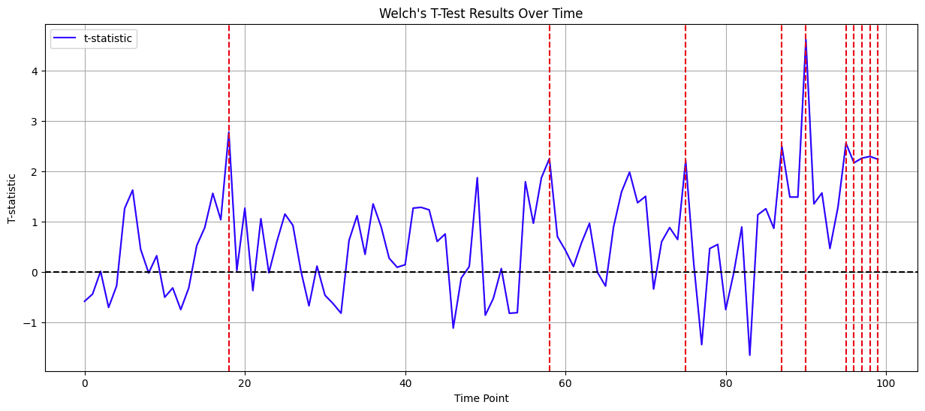
Novel+ Session: Hit & Miss & False Alarm & Reject
Hit & reject
Miss & reject

Slide 16
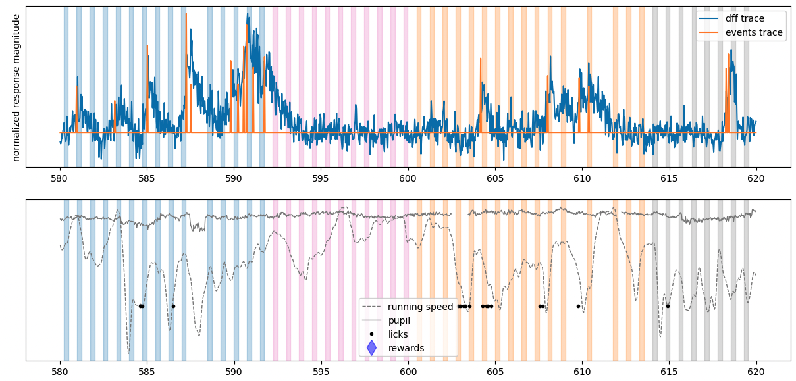
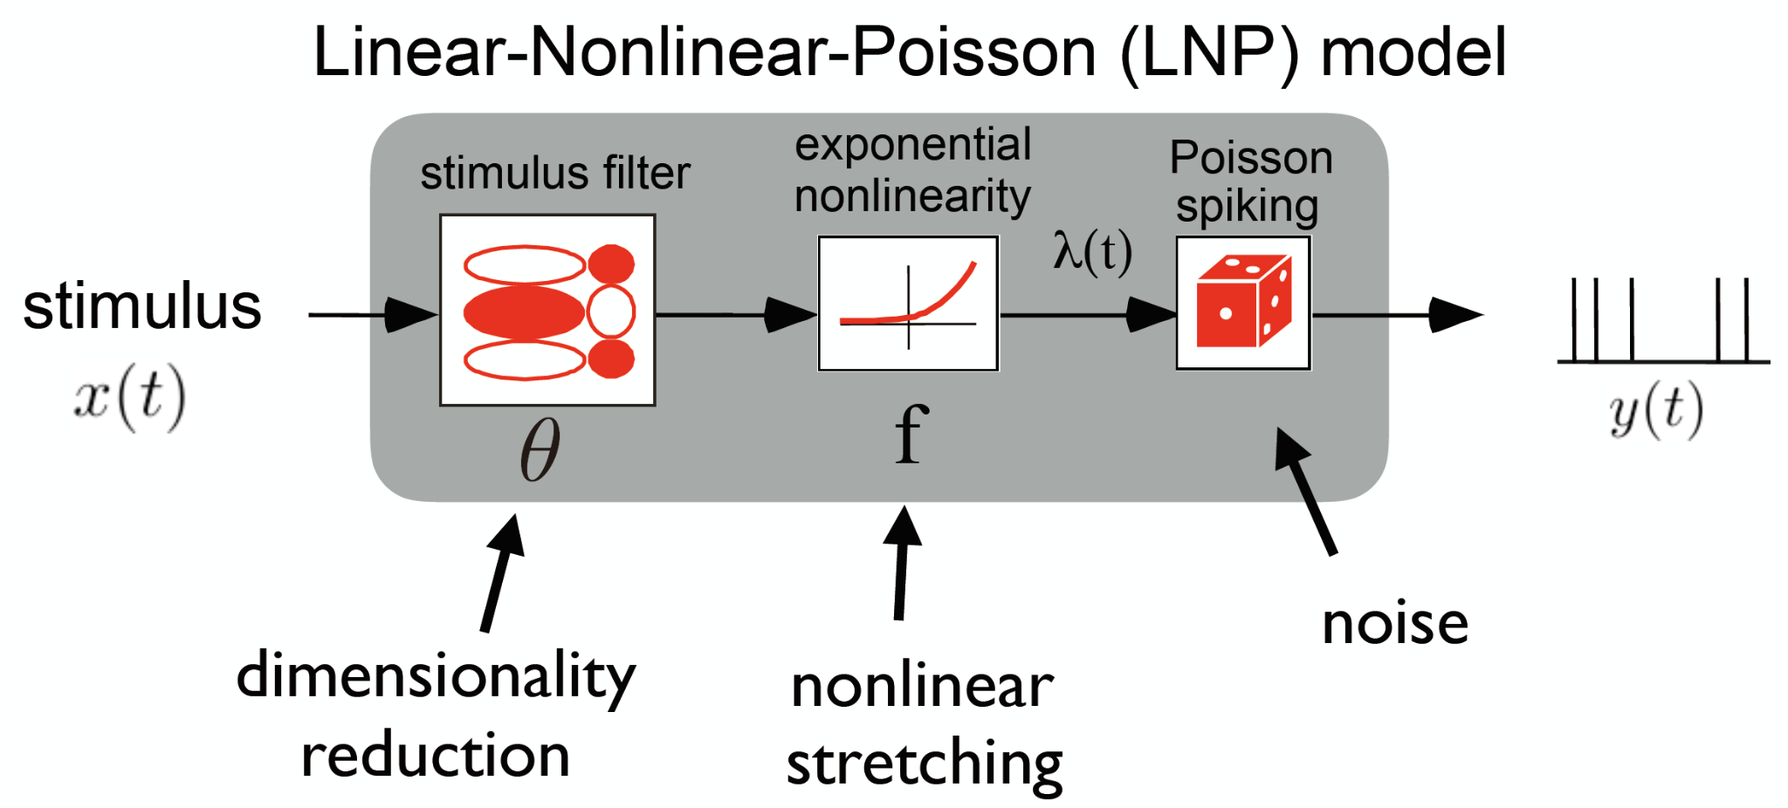
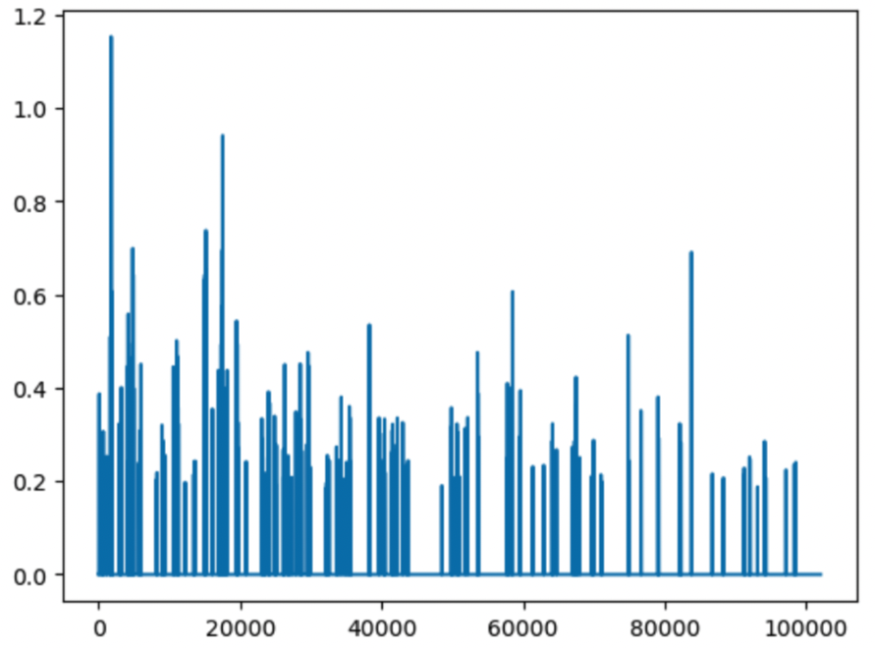
Implementing a GLM model for neural data
Step signal
3s
3s
…
3s
3s
…
3s
3s

Slide 17
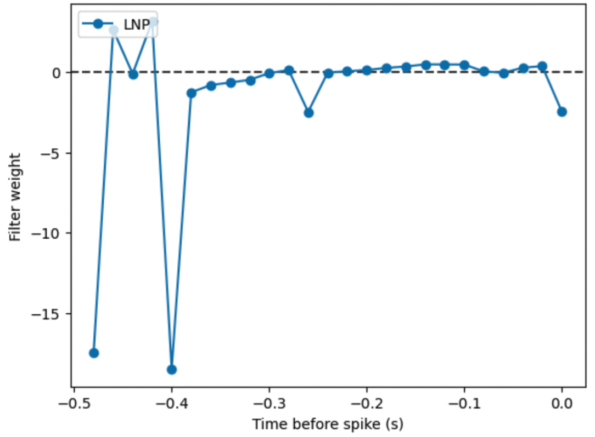
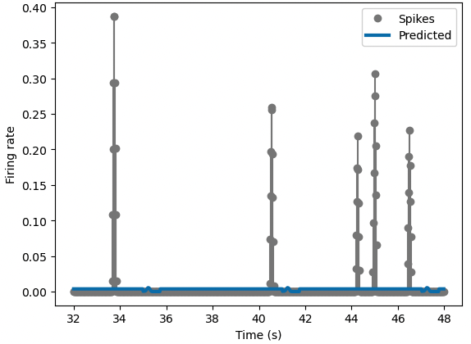
GLM fitting for a VIP neuron

Slide 18
Future Directions
Compare across many sessions and make statistical comparisons of strategy weights
A model to predict/infer “blinks” from mice pupil information
Find common encoding of visual + behavioral actions in neurons
Validate with bigger sample size

